Slide 1





E-MANDI
BY TEAM STRANGERS

Slide 2



Problem Statement
E-Portal for Farmers to sell the produce at a better rate
In India numerous farmers face challenges, in earning a livelihood as they are compelled to sell their agricultural produce to intermediaries at meager prices. These intermediaries act as middlemen who purchase the farmers produce and subsequently sell it to consumers at prices.
To address this issue implementing a platform that enables sales between farmers and consumers could prove instrumental. Such a platform would empower farmers to secure prices for their produce while simultaneously offering consumers the opportunity to purchase goods at more affordable rates.

Slide 3

Idea/Approach Details
Farmers would create an account on the portal and list their produce for sale. The listing would include information such as the type of produce, quantity, quality, and price through SMS.
Buyers would be able to browse the portal and search for produce by type, location, price, and other criteria.
Once a buyer finds a product that they are interested in, they can have a negotiable price decided by farmer and arrange delivery or Delivery Service through application.
The portal could facilitate the payment process between farmers and buyers.
For Quality assurance We will be adding a Rating method based on user feedback.
The portal is integrated with a variety of technologies, including:
Integration platform as a service (iPaaS) to connect the portal to different systems, such as farmer databases, produce databases, and payment systems.
SMS and mobile computing to make it easy for farmers to list their produce for sale and for buyers to purchase produce.
Analytics and data science to provide farmers and buyers with insights into the market.
Data aggregation to collect data from different sources and make it available to portal users.
Data visualization to present data in a clear and concise way.

Slide 4

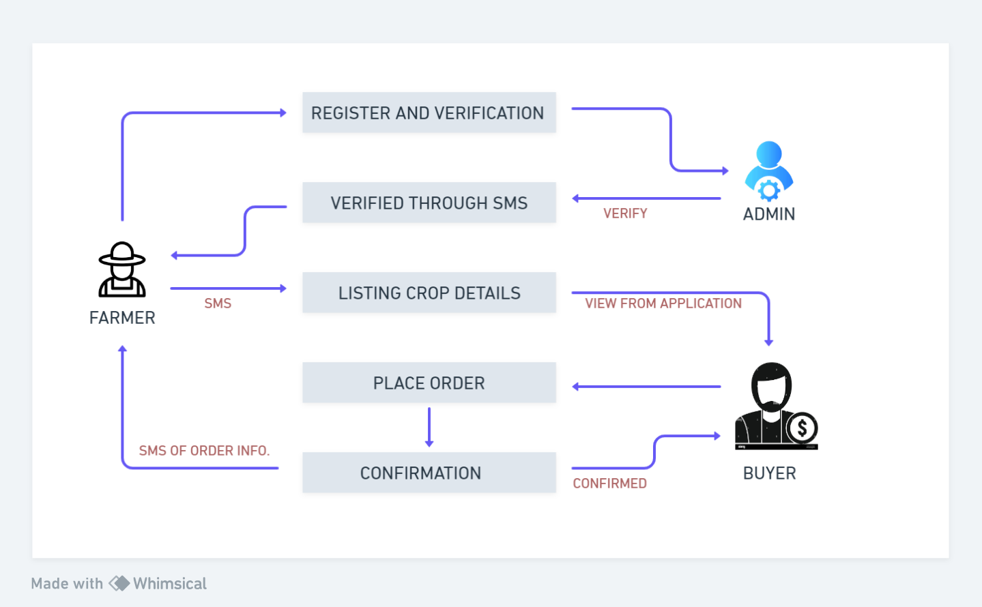
Use Case Diagram

Slide 5





Dependencies
Use Cases
Delivery services to deliver produce to buyers.
DevOps for deployment of application over cloud.
SMS-Service API and Payment Api
Farmers can sell their produce at a better price. By selling directly to buyers, farmers can bypass middlemen and get a higher percentage of the profits.
Farmers can reduce their costs. Farmers can save money on marketing and distribution costs by selling directly to buyers.
Buyers can get fresher produce. When buyers purchase produce directly from farmers, they are getting the freshest produce possible. This is because the produce has not had to travel through a long supply chain.
Buyers can support local farmers. Buying produce directly from farmers helps to support local economies and create jobs.
Technology Used
Show Stoppers
SMS messaging: Farmers can list their produce for sale and communicate with buyers via SMS.
Negotiable rates: Farmers can set their own prices for their produce, and buyers can send offers.
Farmers' identity not revealed: Farmers can use a pseudonym or a unique identifier to protect their privacy.
Fresh products: Farmers can indicate when their produce was harvested, and buyers can rate and review produce listings.
Expedited delivery: The portal can partner with courier companies to offer expedited delivery services.

Slide 6

THANK YOU

